Slide 1
Job Coach Chatbot
Kira & Sandra
Final Project- Ironhack AI Engineering Bootcamp

Slide 2
Expert advice at your fingertips
Problem:
Finding reliable career advice means watching hours of YouTube videos and remembering scattered tips across multiple channels. Career seekers waste valuable time searching through lengthy videos for specific answers.
Solution:
An intelligent RAG-powered chatbot that consolidates expert career advice from top YouTube channels, offering instant and contextual info through both text and voice interfaces.

Slide 3
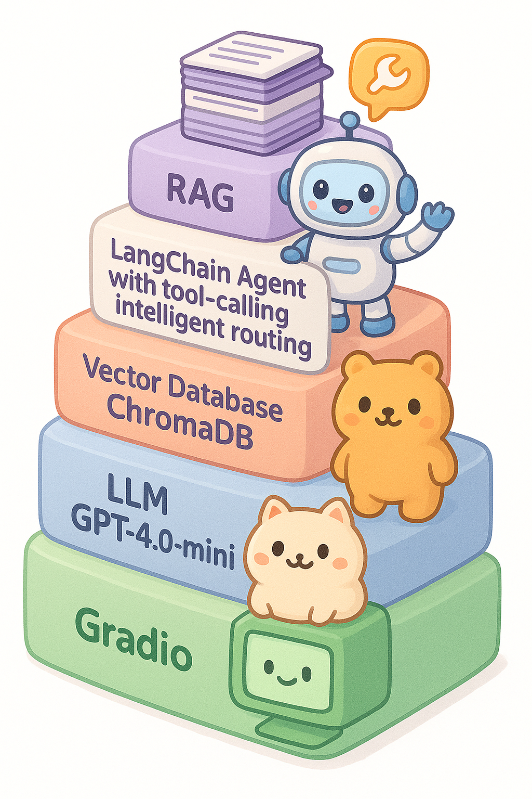
Technical Summary
5- layer architecture
RAG
LangChain Agent with tool- calling for intelligent routing
Vector Database ChromaDB
LLM GPT-40-mini
Gradio

Slide 4
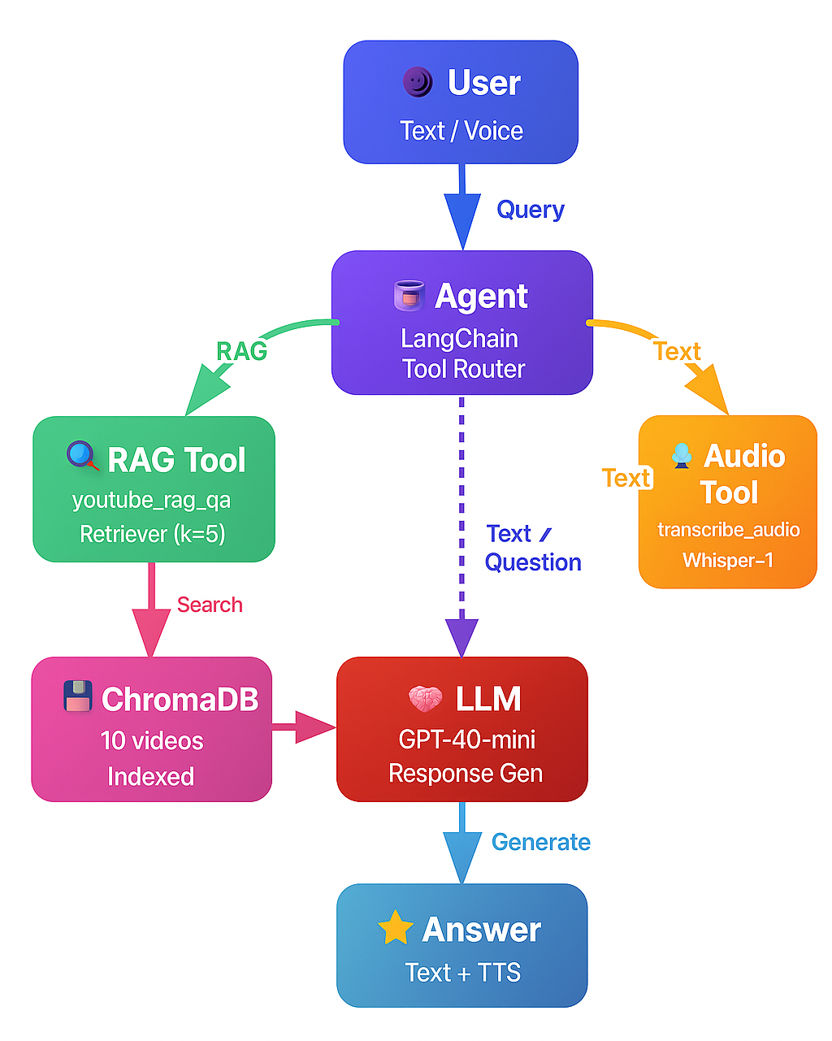
Technical Summary continues
System Workflow: From Question to Answer
User Input → Text or voice question enters the system
Agent Decision → LangChain agent routes to appropriate tool
Tool Execution → Either:
youtube_rag_qa → searches vector database
transcribe_audio_file → converts voice to text first
Context Retrieval → ChromaDB returns 5 most relevant chunks
LLM Generation → GPT-4o-mini creates answer using context
Response → Text answer (+ optional voice output)

Slide 5

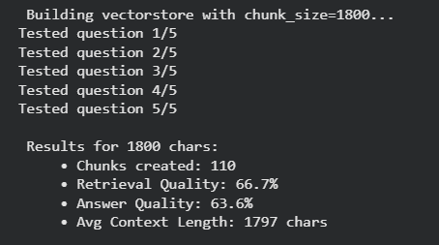
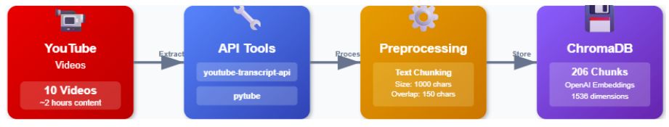
Dataset
Total video hours: 2.7
long explanations
stories
multi-sentence reasoning
multi-step advice
We have less chunks but our answers are more meaningful and have higher quality.
These ideas don’t fit inside tiny chunks like 1000 characters. So a bigger chunk size preserves meaning, which improves answer quality.
Improved route
Our first route

Slide 6
Q&A Agent
Personality (Job coach)
Friendly & encouraging
Clear explanations, no jargon
Supportive, especially when user is unsure
Memory System
RAG Memory
Stores question + used context inside the retrieval pipeline
Session Memory
Saves full conversation history
Lets agent keep track across multiple turns
Components
Retriever: Vector store with k=5 neighbors
LLM: GPT-4o mini with tool-calling enabled
Tool Map: Automatically maps tool names for execution
PromptTemplate
RAG Prompt
Inserts retrieved video chunks
Structures context + question
System Prompt
The LLM always behaves with configured tone
Tools are used appropriately
The conversation memory is respected

Slide 7
Tools
Knowledge Retrieval Tool
youtube_rag_qa — allows the agent access actual information by searching a vector database of YouTube video transcripts and return a relevant answer
Speech Recognition Tool
transcribe_audio_file — lets the agent convert audio input provided by the user into text
Conversation memory
Session_history[session_id] — the agent can remember previous questions and answer during a session
Notes:
Our tools give the agent the following special abilities:
Knowledge Retrieval - How does it work:
We split transcripts into chunks and stored them with metadata
When a user asks a question, this tool retrieves the most relevant chunks and the LLM can generate an answer
Speech Recognition - How does it work:
The tool transcribes speech to text (OpenAI Whisper)
The agent receives the transcription
It can then process the text like a normal question
Conversation memory so the agent remembers previous questions and answers during a session

Slide 8
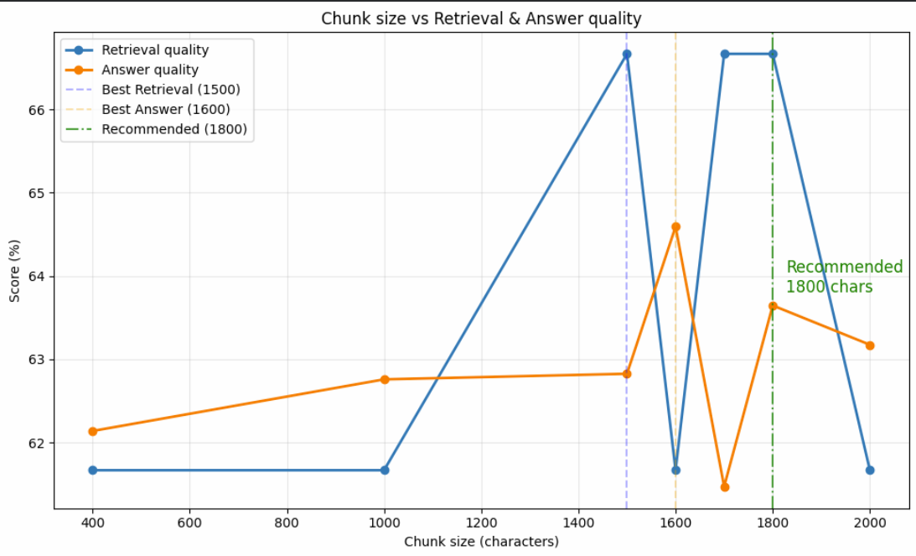
Evaluation
Manual testing
Test setup: Created a set of test cases for each video and included factual and clarification questions
Evaluation criteria: Relevance, Accuracy, Completeness, Clarity
Findings: Providing general information
Improvements:
Refined prompts
Improved chunking and retrieval
Notes:
Goal: measure how well the chatbot answers questions about context in the YouTube videos
To evaluate the system, we created a set of test cases for each video with factual clarification questions
We evaluated the answers on four criteria: relevance, accuracy, completeness, and clarity.
We noticed a few common issues: Some answers were too general and sometimes the bot slightly misquoted the video.
We refined our prompts and adjusted chunking and retrieval based on …

Slide 9
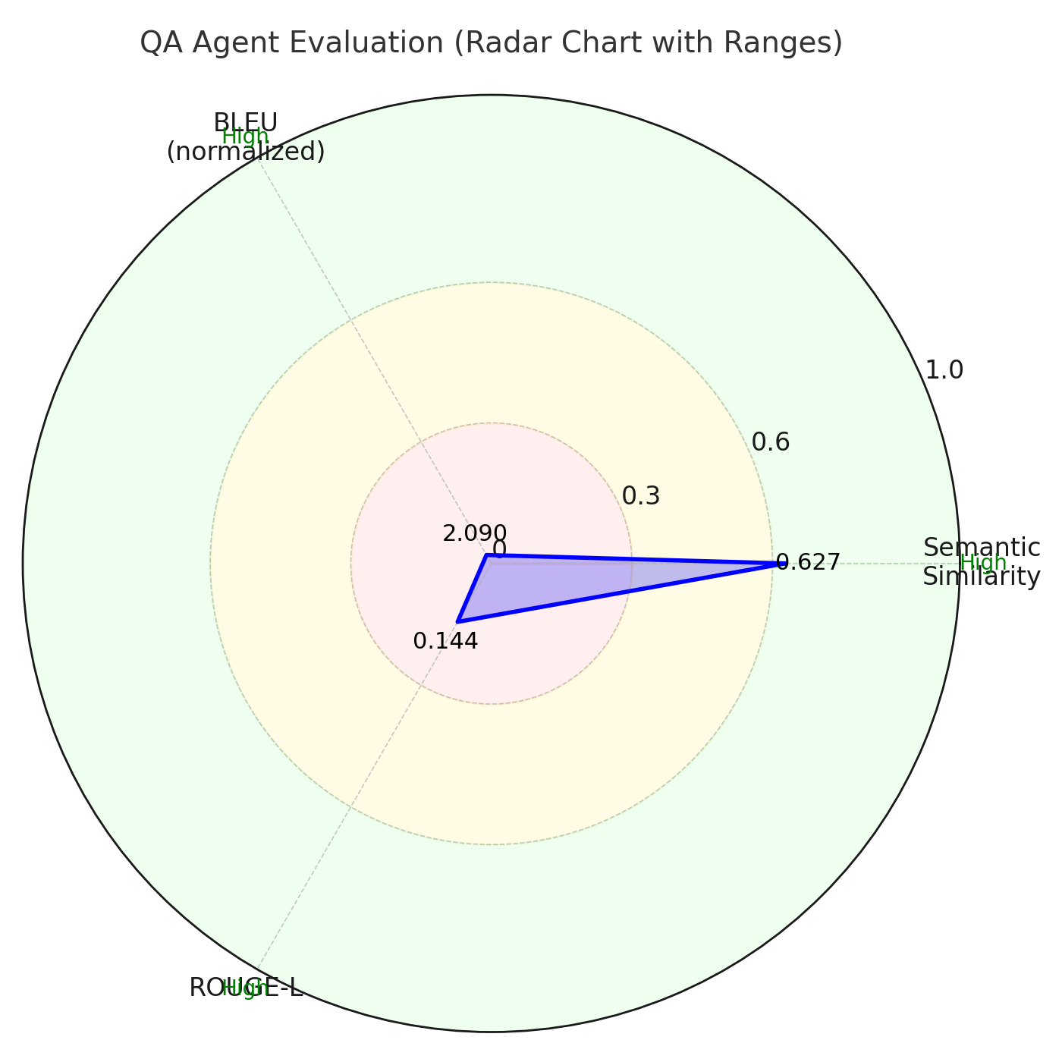
Evaluation
Automated testing
Collected 50 questions and reference answers by running our transcript files through chat gpt
Semantic Similarity score to understand if the meaning matches
Textual Similarity score:
BLEU-Metric: How similar are the small word phrases
ROUGE-L-Metric: How similar is the overall structure or flow
Notes:
For automated testing, we collected 50 questions and reference answers. We did that by uploading our transcript files to chat gpt and asked for specific QAs.
We evaluated two things:
First, semantic similarity – whether the meaning matches,
Second, textual similarity – whether the wording or structure matches.
Our average semantic score was 0.627, which means the model was mostly correct in meaning.
BLEU and ROUGE were very low → the model rarely used the same wording
Overall, the model captures the general ideas, but expresses them at a higher level

Slide 10
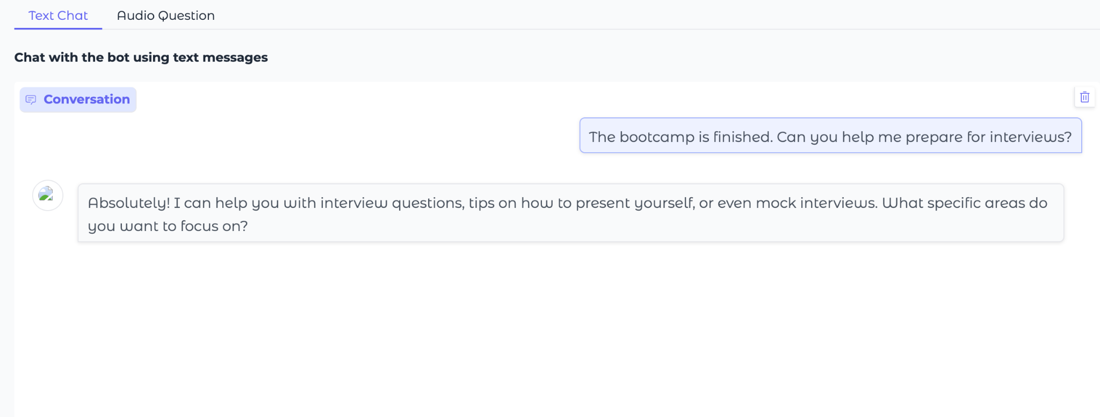
Conclusion

Slide 11
Demo
https://154265ed138026c588.gradio.live/

